Slide 1

Introduction to app development & Flutter
Narayan vyas
Sr. Developer, Flexxited

Slide 2
Mobile app development
Mobile application development is the process of creating software applications that run on a mobile device, and a typical mobile application utilizes a network connection to work with remote computing resources.

Slide 3
App development approaches
Various Technologies are used for Mobile App Development which are classified as –
Native Approach
Hybrid Approach
Cross-Platform Approach

Slide 4
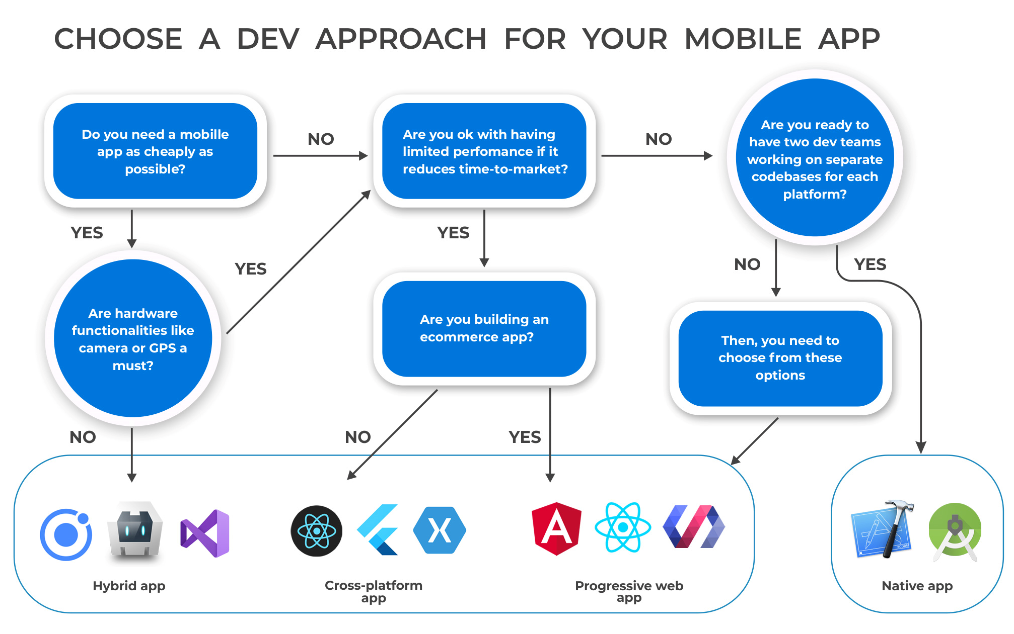

Slide 5
What is flutter?
Flutter is an open-source UI software development kit created by Google. It is used to develop cross platform applications for Android, iOS, Linux, Mac, Windows, Google Fuchsia, and the web from a single codebase.
The first version of Flutter was known as codename "Sky" and ran on the Android operating system.
Initial release date of Flutter was May 2017.

Slide 6
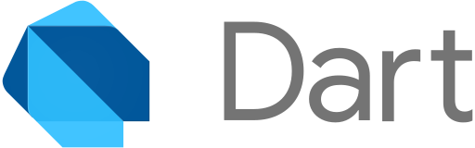
What is Dart?
Dart is a programming language designed for client development, such as for the web and mobile apps.
It is developed by Google and can also be used to build server and desktop applications.
Dart is an object-oriented, class-based, garbage-collected language

Slide 7
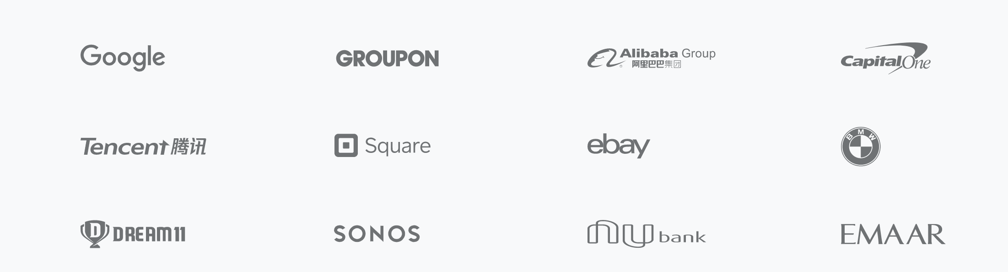
organizations working with Flutter

Slide 8
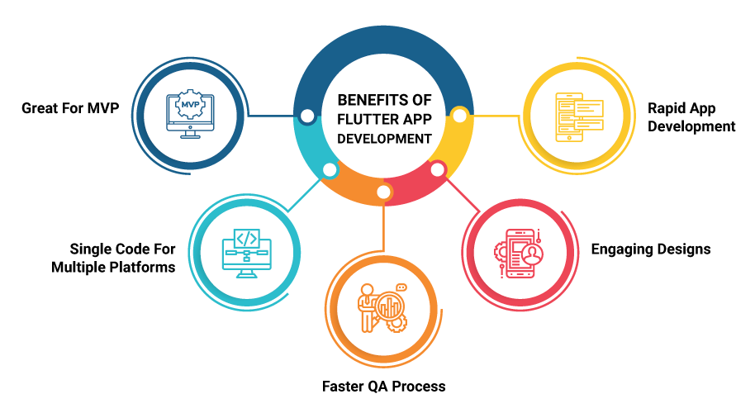
Why flutter

Slide 9
What are widgets?
Flutter widgets are built using a modern framework that takes inspiration from React. The central idea is that you build your UI out of widgets.
Widgets describe what their view should look like given their current configuration and state. When a widget’s state changes, the widget rebuilds its description.
Examples – Container, Row, Column, Image, Icon etc.

Slide 10
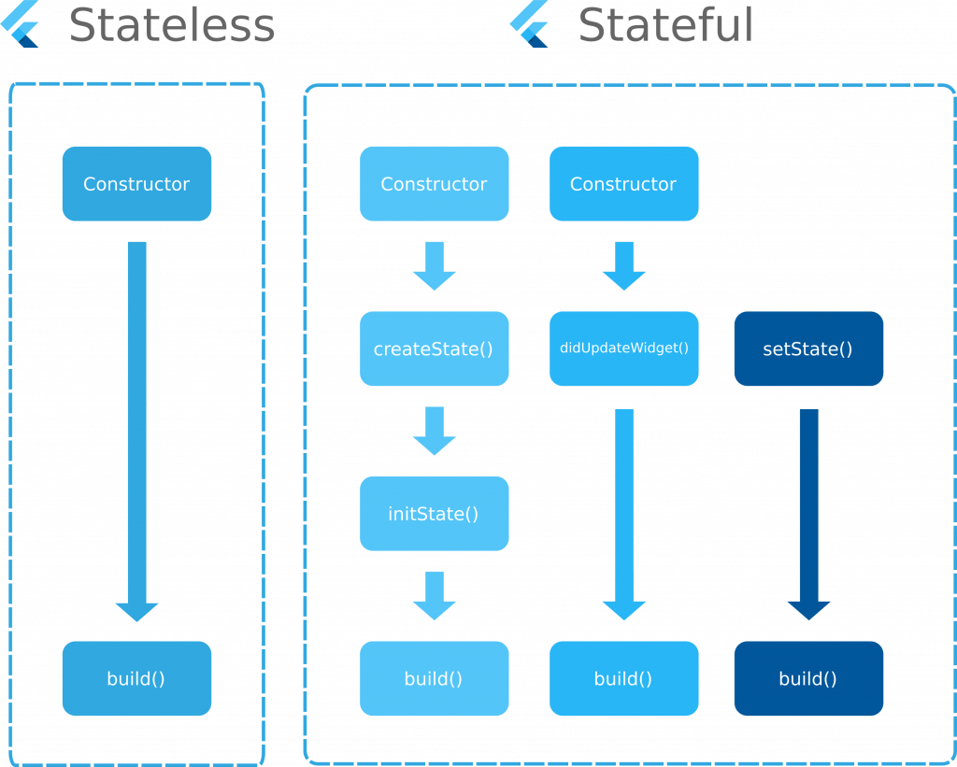
Cannot be updated on user interaction
Shortcut - stl
Can be updated on user interaction
Shortcut - stf

Slide 11
Material app
MaterialApp is a predefined class in a flutter.
It is likely the main or core component of flutter. We can access all the other components and widgets provided by Flutter SDK.
MaterialApp is a widget that introduces many interesting tools such as Navigator or Theme to help you develop your app. Material is, on the other hand, a widget used to define a UI element respecting Material rules.

Slide 12
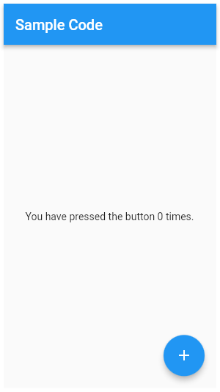
Scaffold
Implements the basic material design visual layout structure.
This class provides APIs for showing drawers and bottom sheets.

Slide 13
Appbar widget
A material design app bar consists of a toolbar and potentially other widgets, such as a TabBar and a FlexibleSpaceBar.
App bars typically expose one or more common actions with IconButtons

Slide 14
Container widget
The Container widget lets you create a rectangular visual element. A container can be decorated with a BoxDecoration, such as a background, a border, or a shadow.
A Container can also have margins, padding, and constraints applied to its size. In addition, a Container can be transformed in three dimensional space using a matrix.

Slide 15
Row, column widgets
These flex widgets let you create flexible layouts in both the horizontal (Row) and vertical (Column) directions.
The design of these objects is based on the web’s flexbox layout model.
Row is widget that displays its children in a horizontal array.
Column is a widget that displays its children in a vertical array.

Slide 16
Text widget
The Text widget displays a string of text with single style.
The string might break across multiple lines or might all be displayed on the same line depending on the layout constraints.
The style argument is optional.

Slide 17
Icons
A graphical icon widget drawn with a glyph from a font described in an IconData such as material's predefined IconDatas in Icons.
Icons are not interactive. For an interactive icon, consider material's IconButton.

Slide 18
Image widget
A widget that is used to display images in the application.
Several constructors are provided for the various ways that an image can be specified:
new Image, for obtaining an image from an ImageProvider.
new Image.asset, for obtaining an image from an AssetBundle using a key.
new Image.network, for obtaining an image from a URL.
new Image.file, for obtaining an image from a File.
new Image.memory, for obtaining an image from a Uint8List.

Slide 19
drawer widget
In apps that use Material Design, there are two primary options for navigation: tabs and drawers. When there is insufficient space to support tabs, drawers provide a handy alternative.
In Flutter, use the Drawer widget in combination with a Scaffold to create a layout with a Material Design drawer. This recipe uses the following steps:

Slide 20
Packages in flutter
Flutter supports using shared packages contributed by other developers to the Flutter and Dart ecosystems.
This allows quickly building an app without having to develop everything from scratch.
Website to check all the packages available – https://pub.dev

Slide 21
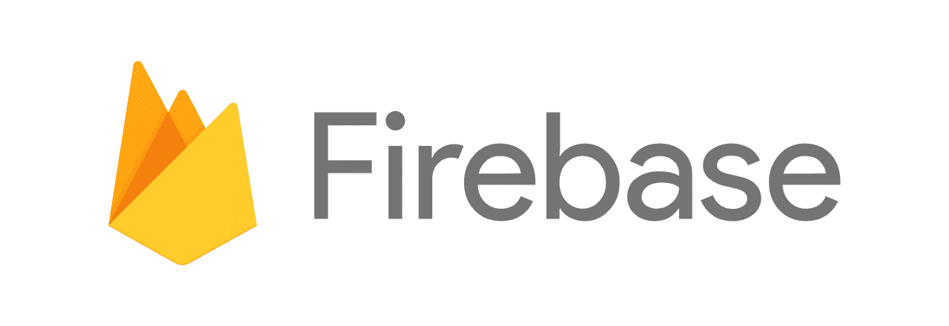
firebase
Firebase is a platform developed by Google for creating mobile and web applications. It was originally an independent company founded in 2011.
In 2014, Google acquired the platform and it is now their flagship offering for app development.

Slide 22
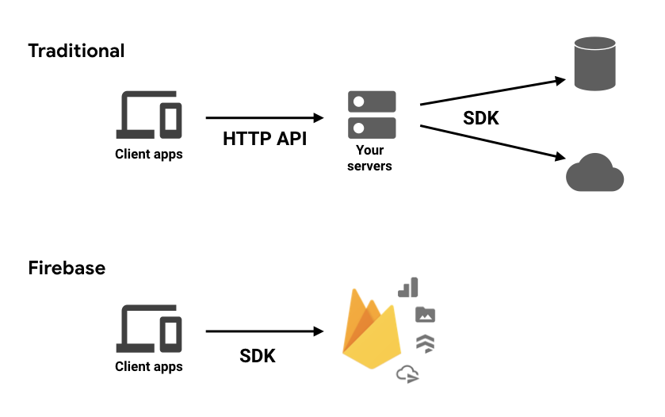
Why firebase?

Slide 23
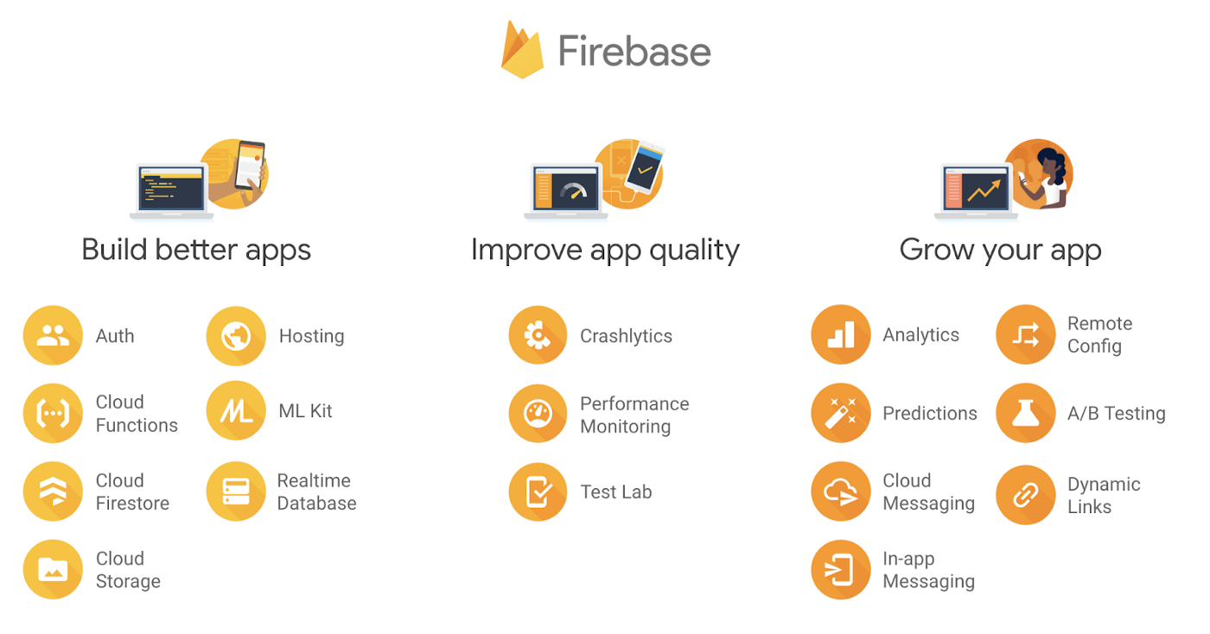

Slide 24
Nosql databases
A NoSQL database provides a mechanism for storage and retrieval of data that is modeled in means other than the tabular relations used in relational databases.
NoSQL, also referred to as “not only SQL” or “non-SQL,” is an approach to database design that enables the storage and querying of data outside the traditional structures found in relational databases.

Slide 25
Cloud firestore vs realtime database
Cloud Firestore is Firebase's newest database for mobile app development. It builds on the successes of the Realtime Database with a new, more intuitive data model. Cloud Firestore also features richer, faster queries and scales further than the Realtime Database.
Realtime Database is Firebase's original database. It's an efficient, low-latency solution for mobile apps that require synced states across clients in realtime.

Slide 26
Thank you
GitHub URL - https://github.com/narayanvyas/flutter_workshop
Narayan Vyas
Sr. Developer, Flexxited, Bangalore
www.narayanvyas.org

